Slide 1
Scientific Machine Learning for Modeling and Control of District Energy Systems
Ján Drgoňa
Associate Professor Civil and Systems Engineering Department Electrical and Computer Engineering Department (secondary) The Ralph O'Connor Sustainable Energy Institute (ROSEI)
Data Science and AI Institute (DSAI)

Slide 2
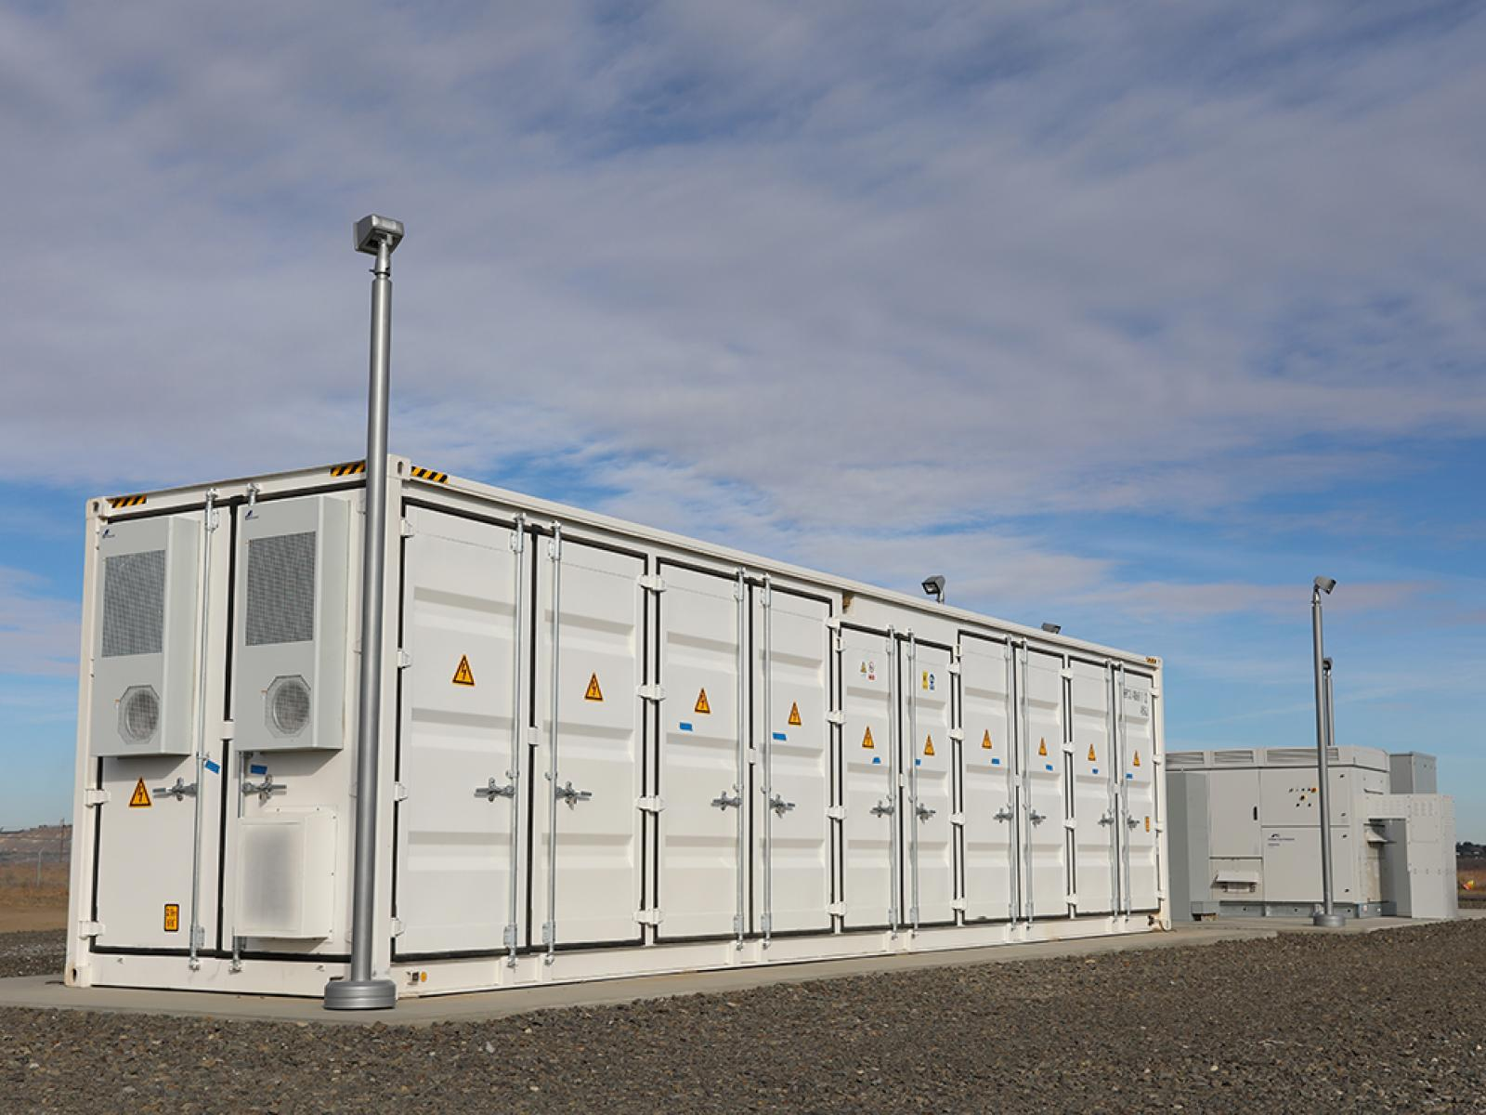




Optimizing Complex Energy Systems is Hard
Simulations are crucial for optimal decision-making in complex energy systems
Need: Improve computational efficiency and scalability of digital twins and optimization-based decision-making
Challenges:
Modeling and simulation of complex systems is hard
Closed-loop control of complex systems is hard-er
Scientific computing and machine learning tools are fragmented and not easily composable

Slide 3
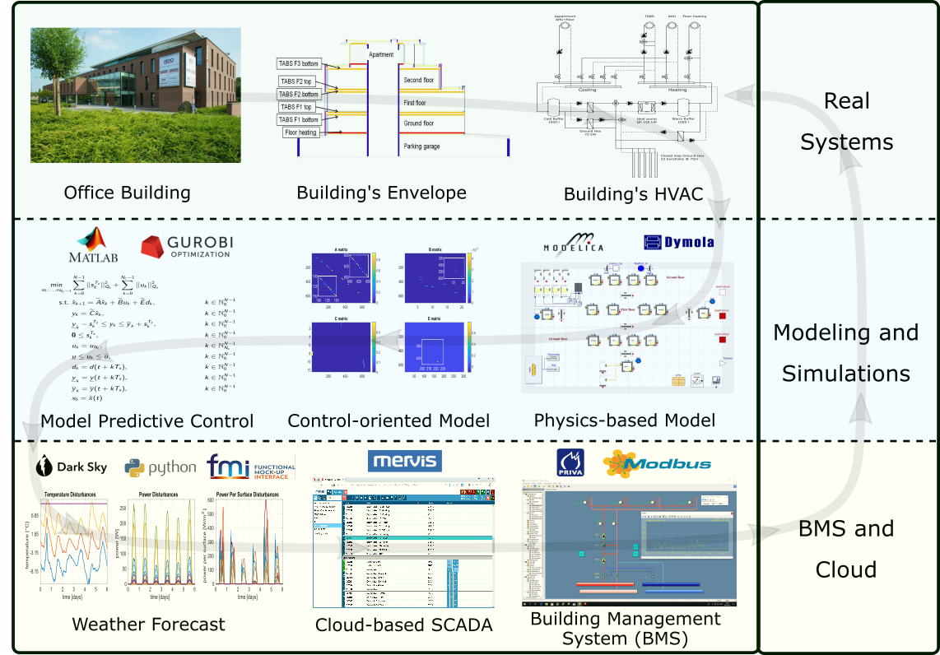
Example: Optimal Control of Building Energy Systems
Motivation
Buildings today contribute to approximately 40% of the global energy use.
Existing control solutions governing building energy systems are very inefficient.
Drgona J., et al., Cloud-based implementation of white-box model predictive control for a GEOTABS office building: a field test demonstration. Journal of Process Control, 2020.

Slide 4
Example: Optimal Control of Building Energy Systems
Upside
Heat pump energy savings up to 53%.
Improvement of thermal comfort up to 37%.
Drgona J., et al., Cloud-based implementation of white-box model predictive control for a GEOTABS office building: a field test demonstration. Journal of Process Control, 2020.

Slide 5
Example: Optimal Control of Building Energy Systems
Upside
Heat pump energy savings up to 53%.
Improvement of thermal comfort up to 37%.
Downside
Project duration: 1 year.
Expertise required: 6 staff with advanced engineering degree.
Drgona J., et al., Cloud-based implementation of white-box model predictive control for a GEOTABS office building: a field test demonstration. Journal of Process Control, 2020.

Slide 6
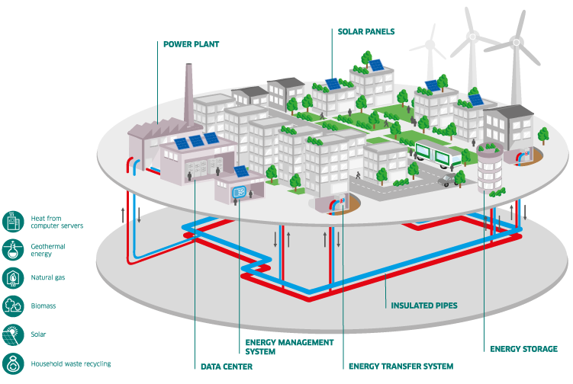
Remaining Challenges in Modeling and Control of HVAC and District Energy Systems
Cost and time efficient deployment of advanced control strategies remains main challenge.
High-fidelity digital twins require:
Scalable control-oriented surrogates to partial differential equations (PDEs)
Multi-physics and multi-scale modeling
Adaptive data-driven modeling
Handling energy and mass conservation laws
Ability to model systems of systems
Optimal control deployments require:
Handling of multi-objective tradeoffs such as grid-responsive and compute-aware objectives
Constraints satisfaction for safety and performance guarantees
Handling uncertainty and operational variability
Mixed-integer action spaces
Robust digital infrastructure
https://fvbenergy.com/district-energy/

Slide 7
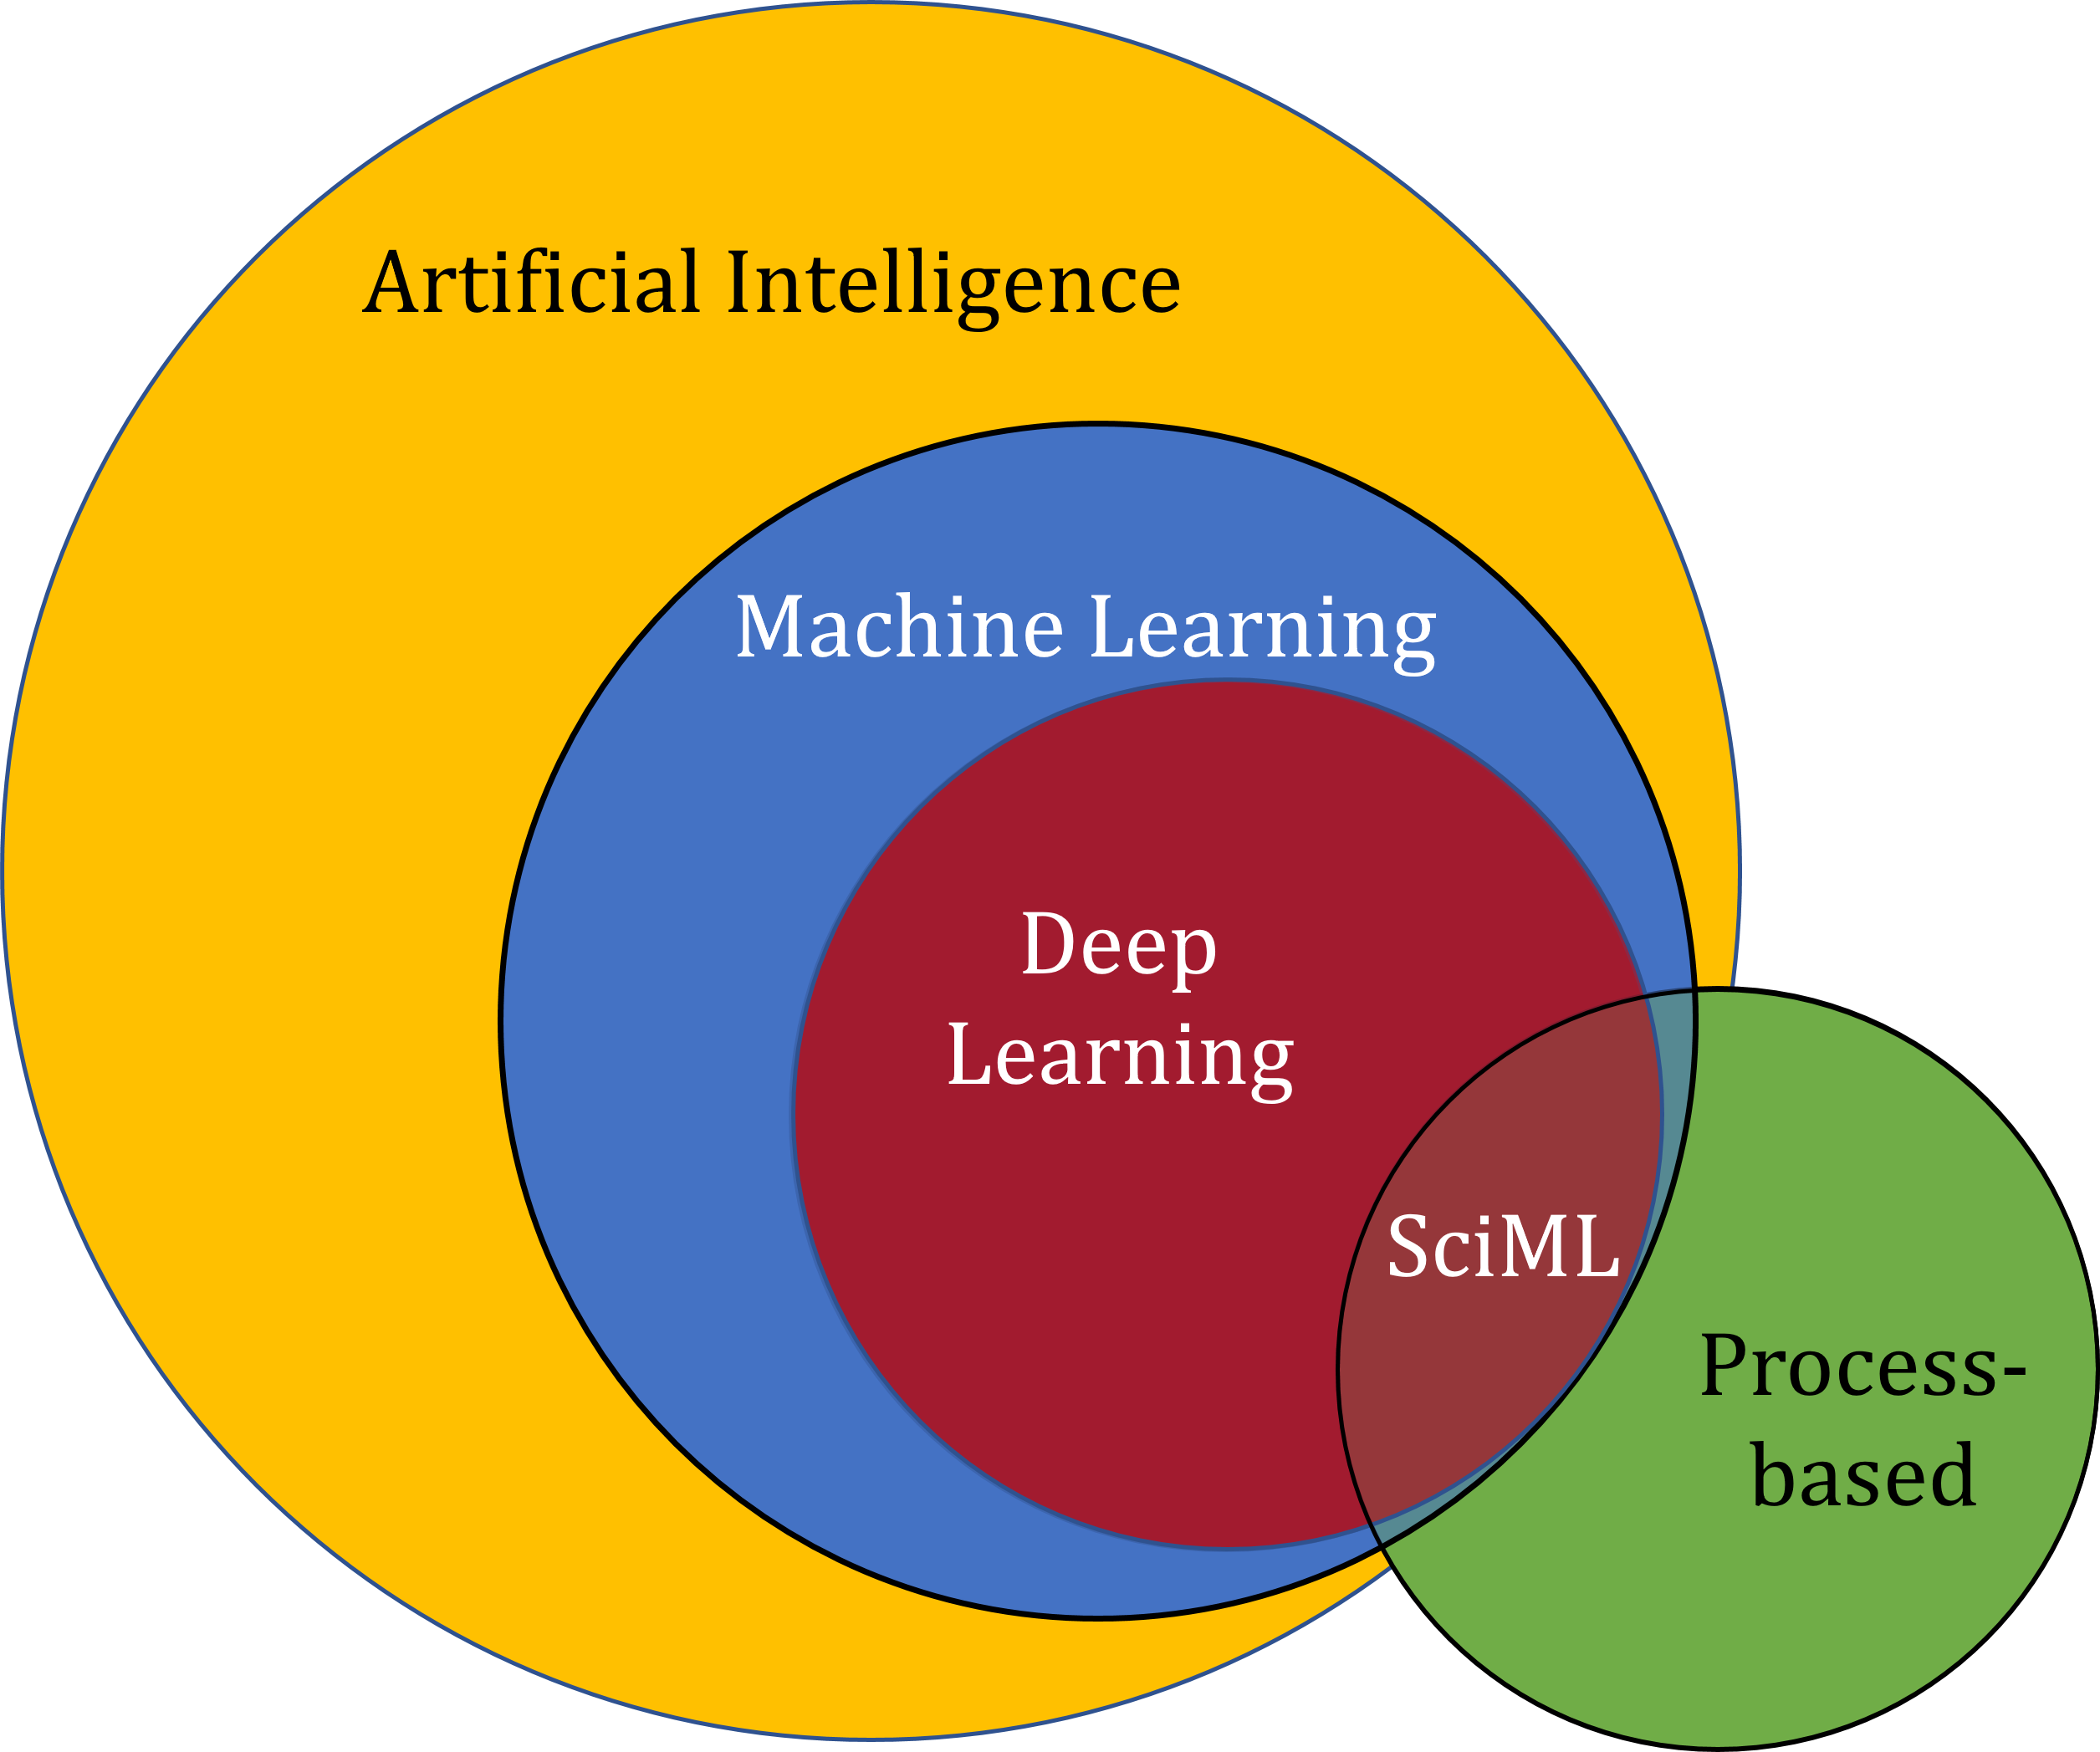
Scientific Machine Learning (SciML)
What?
SciML systematically integrates ML methods with mathematical models and algorithms developed in various scientific and engineering domains
Why?
Scientific applications are governed by fundamental principles and physical constraints
Purely data-driven “black box” ML methods cannot satisfy underlying physics
How?
Leverage automatic differentiation used in learning for modeling, optimization, and control
Karniadakis, G.E., Kevrekidis, I.G., Lu, L. et al. Physics-informed machine learning. Nat Rev Phys 3, 422–440, 2021.
Image source: https://sciml.wur.nl/reviews/sciml/sciml.html

Slide 8


NeuroMANCER Scientific Machine Learning Library
Five years in development by leading experts in academia and national labs.
Open-source library in PyTorch
Physics-informed Neural Networks
Learning to optimize
Neural differential equations
Learning to control
github.com/pnnl/neuromancer

Slide 9


Example Application: Heating Ventilation and Air Conditioning (HVAC) Systems in Buildings
Benefits of Scientific Machine Learning
Modeling and optimal control design is roughly 10-times faster and requires less expertise.
Real-time decisions are made orders of magnitude faster than traditional model-based approaches.
J. Drgona, et al., Physics-constrained deep learning of multi-zone building thermal dynamics, Energy and Buildings, 2021
J. Drgona, et al., Deep Learning Explicit Differentiable Predictive Control Laws for Buildings, IFAC NMPC 2021

Slide 10
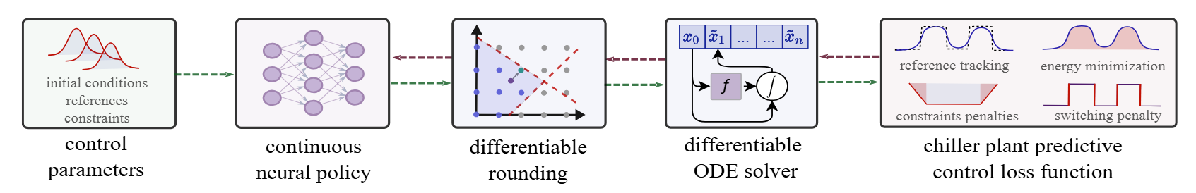
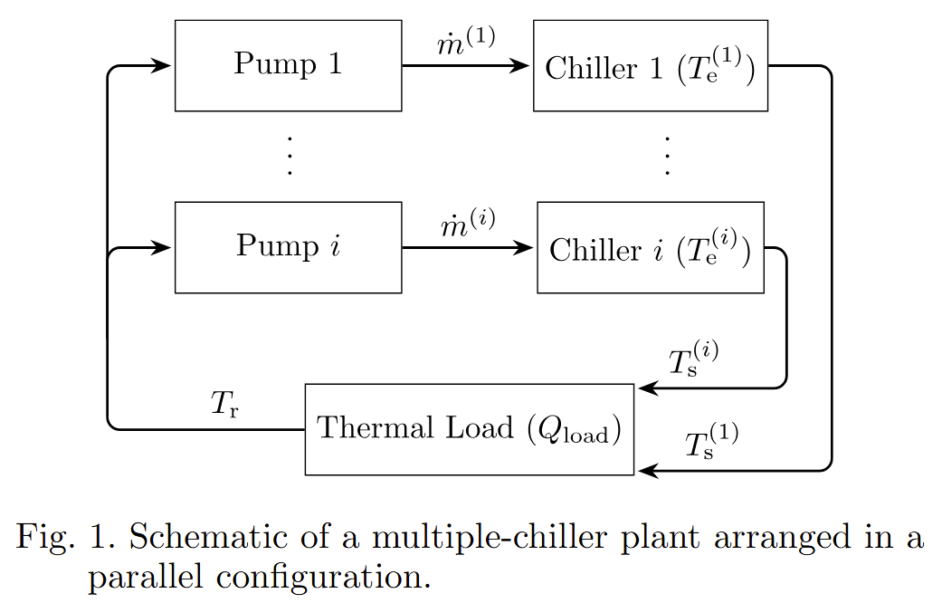
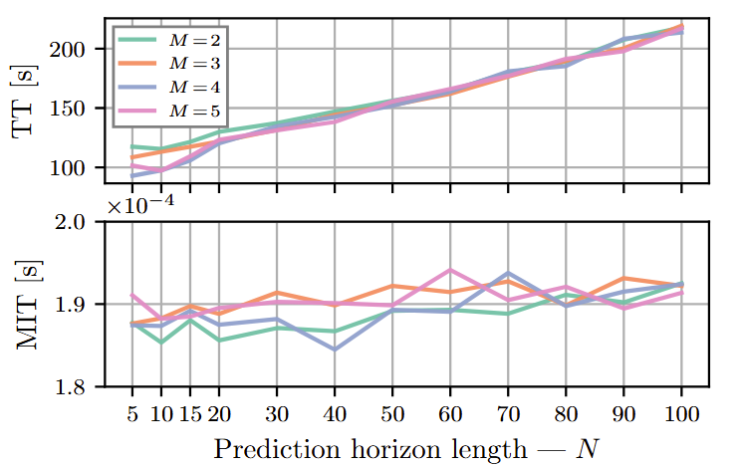
Example Application: Cooling of Data Centers
Benefits of Scientific Machine Learning
Computationally tractable solution of mixed-integer nonlinear optimal control problems.
Real-time decisions are made orders of magnitude faster than traditional model-based approaches.
Ján Boldocky, Cary Faulkner, Elad Michael, Martin Gulan, Aaron Tuor, Ján Drgoňa, Data Center Chiller Plant Optimization via Mixed-Integer Nonlinear Differentiable Predictive Control, under review, 2025

Slide 11

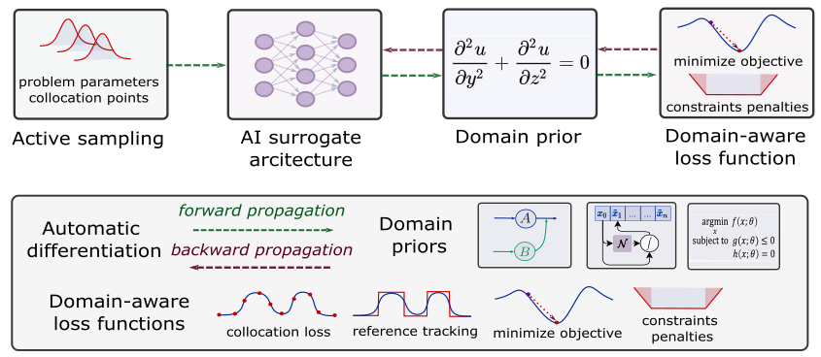
Summary
Scientific machine learning (SciML) represents set of methods that integrate modern AI with scientific computing.
SciML enables scalable modeling and control of complex energy systems.
Team has over a decade of experience in applied energy research including real-world deployment studies.
Contact information
drgona.github.io/
jdrgona1@jh.edu

